Slide 1


Slide 2
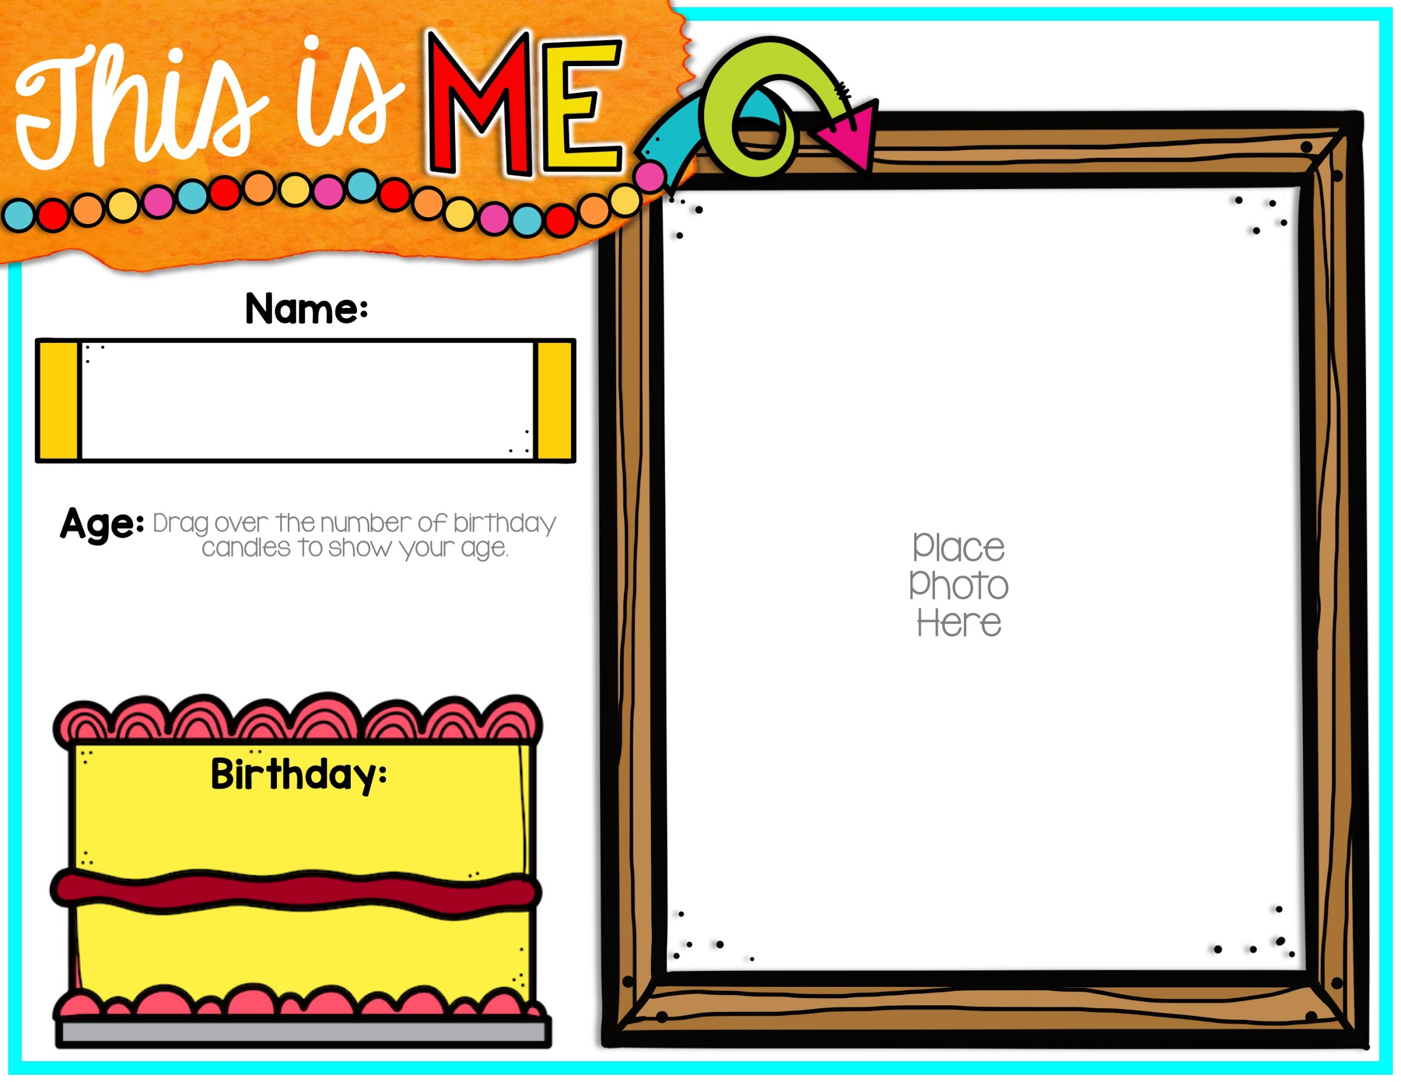




Slide 3
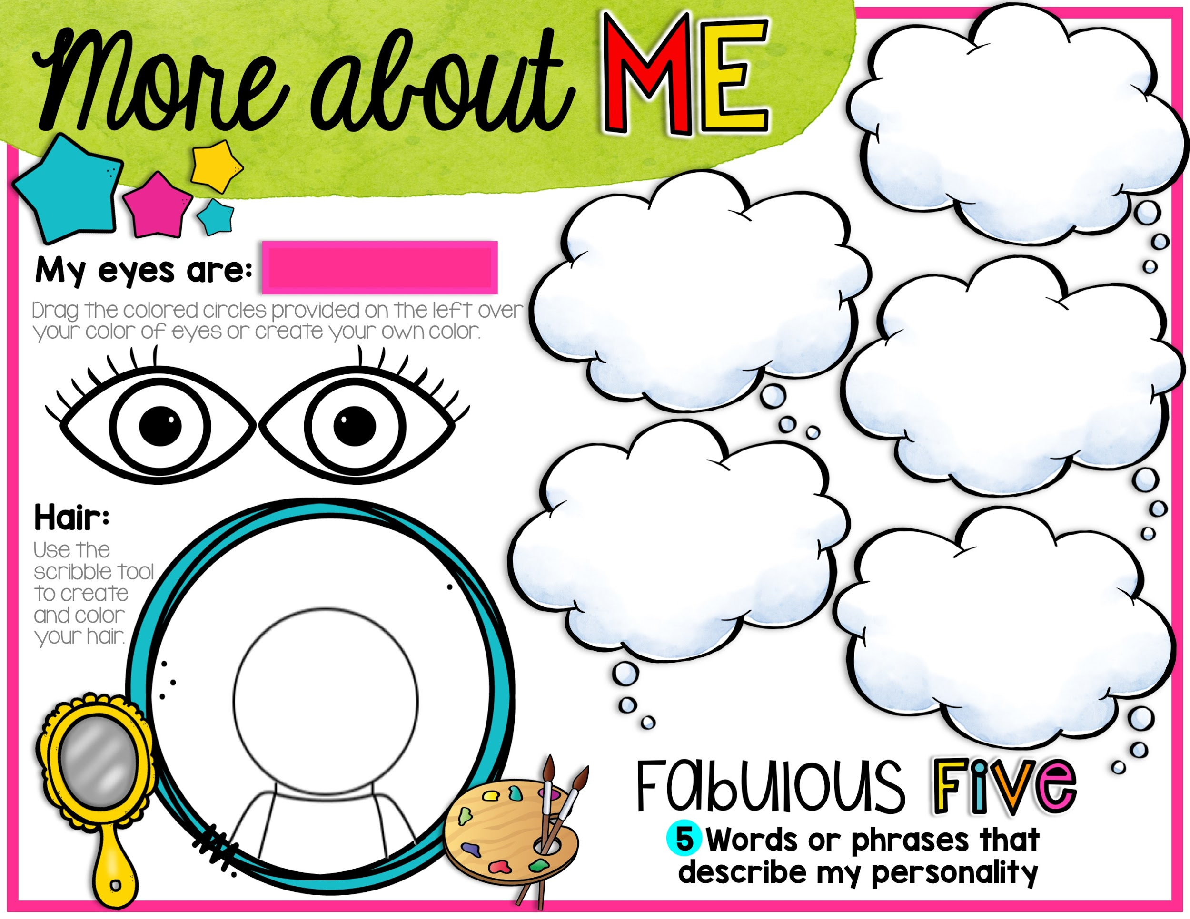


Eye Options:
The scribble tool can be found by going to “line” and
selecting .

Slide 4


Slide 5


Slide 6

Tip: You can search the internet for pictures of your favorite things to add as well!

Slide 7


Slide 8


Slide 9


Slide 10


Slide 11


Slide 12


Slide 13


Slide 14

Tip: You can search the internet for a picture of your future job to add as well!

Slide 15


